Slide 1
Linux Administration
Week 5
Networking

Slide 2
Connecting your Linux computer to a network is pretty straightforward, except when it is not.

Slide 3
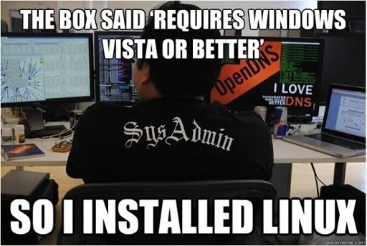
Activity
Install the networking Tools on one server
Package is called net-tools
Install networking tools in your second server
Install networking tools in your second machine at home if you don't have time today

Slide 4
Networking and Distros
There is a huge amount of variability by distro
Some you need to edit the configs
Some rewrite the config by script every boot
Some have a specialized app

Slide 5
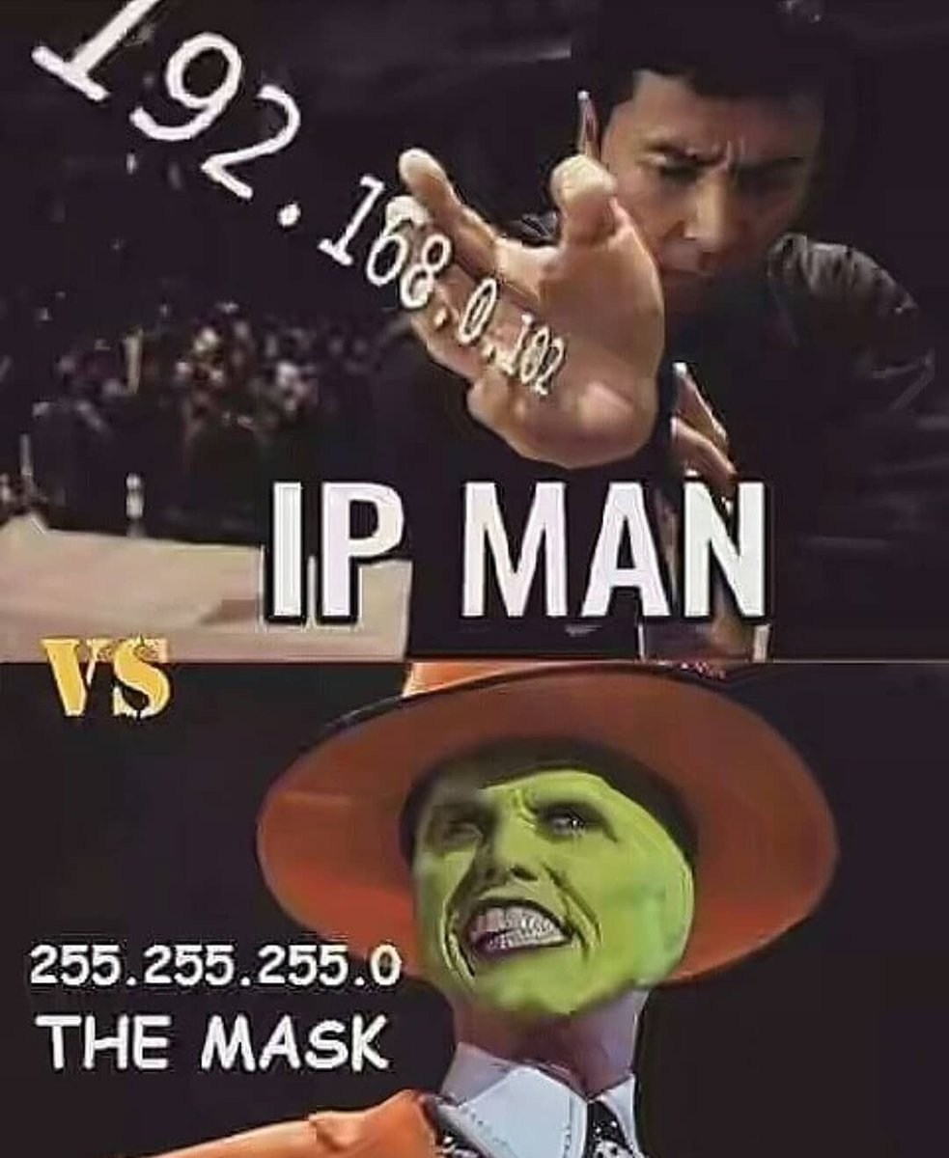
What should you worry about first?
Setting IP addresses
Static vs dynamic
Example: as admin, should you have a static IP address in case you need to seriously lock down the server during a hack?
Setting DNS
Naming interfaces
IPv4 vs IP v6

Slide 6
Example: Networking and Red Hat
Default service in Red Hat 7 is NetworkManager | Default service in Red Hat 9 is NetworkManager
Networking scripts in Red Hat 7 can run in parallel
Lives in /etc/init.d/network | Lives in /etc/NetworkManager/system-connections/
Can be run manually systemctl start|stop|restart|status network | Multiple tools built in such as systemctl and nmcli
https://access.redhat.com/documentation/en-us/red_hat_enterprise_linux/7/html/networking_guide/sec-using_networkmanager_with_network_scripts | https://access.redhat.com/documentation/en-us/red_hat_enterprise_linux/9/html-single/configuring_and_managing_networking/index#doc-wrapper
Modification of ANY files in networking packages or related rpms Red Hat no long provides support

Slide 7
Example: Networking and Debian
/etc/network/interfaces is the config file
/etc/resolve.conf is for the nameservers
Resolveconf is a program (Different then resolve.conf) that works on the resolve.conf file
Resolveconf is optional
There is a GUI
Automatic network config tools are NOT for servers, desktop users only.
https://wiki.debian.org/NetworkConfiguration

Slide 8
Activity
Find where your second server (not CentOS) keeps the networking info. Pull up the documentation, look at the config file/script/tool.
What do you see?
Where is your networking info located?
Does it use a script?
Conf file?
Tool?
Special commands?

Slide 9
Legacy issues
Ifconfig
Technically legacy
Used to configure, display and control network interfaces
Still used A LOT especially by people who have been doing Linux for a while (change is unwelcome by some in the community)
Ip
New way to do what ifconfig does
https://web.archive.org/web/20220717053351/https://www.tecmint.com/ifconfig-vs-ip-command-comparing-network-configuration/

Slide 10
Important commands to know
Ifup and ifdown
Ping
Tracepath
Netstat (legacy) new command is ss
Dig
Nslookup
Route
Host
Arp
Ethtool
Iwconfig
Hostname
System-config-network (GUI)

Slide 11
Activity
Try each of the following commands:
Ping
Ifup and Ifdown
If you can't, or don't have permissions that's ok.
Ss
Tracepath
Hostname
Pick another command from the list https://web.archive.org/web/20220602224947/https://www.tecmint.com/linux-networking-commands/ and try it out too.

Slide 12
Networking Troubleshooting
Think back to your Networking Courses
OSI model vs the TCP/IP model
You can troubleshoot going through each layer
Make some guesses as to where the issue is based on problem.

Slide 13
Where to start troubleshooting examples
One way to start troubleshooting is by model layer
Network access or Physical layer: Is the cable unplugged? Is the interface up?
Data link Layer: did the ARP entry come up correctly?
Networking/Internet layer: Do you have a unique IP address? Is your DNS correct?
Transport layer: Is the correct port open?
Application layer: Is the program I'm trying to use installed? Updated? Is the Daemon running?
A second way to start troubleshooting is to ask questions of yourself and the server
Why am I unable to ping a known address?
What's my error message?
What's the most common issues and have I checked them?
What changed from the last time I used this machine?

Slide 14
Activity
For each scenario come up with some ideas on what could cause them
Example: NO internet access at all for anyone in the whole company
Example: Very few web pages are not able to be accessed
Example: Internet is up everywhere but the server
Example: You can access the internet from your server, but you can't ping or ssh into the server.

